Slide 1
Dear author,
Please prepare your presentation according to this template (Widescreen 16:9)
Also read the NOTES (View/Notes Page) below each slide for further guidelines
You will have 20min for your presentation and 5min for questions – therefore aim for 20 - 25 slides as a general guideline
See you soon in Cape Town!
< DELETE THIS BOX WHEN DONE >
Notes:
Keep this slide unchanged as SLIDE 1 of your presentation. DO NOT DELETE!
There is also an alternative SLIDE 1 under “Layout”.

Slide 2
Name of Author(s)
Affiliation(s)
Contact details
Logo
Notes:
This is SLIDE 2 with the Title of the presentation and the details of the Author(s).
You are welcome to add company logo(s) or change the banner image at the bottom of the slide.

Slide 3
Slide heading [slide with text]
Bullet 1
Bullet 1a
Bullet 1b
Bullet 1c
Bullet 2
Bullet 3
Notes:
Normal slide with heading and text.
Please do not reduce the size of the text any further.
You can also add images or graphs to the right on this slide

Slide 4
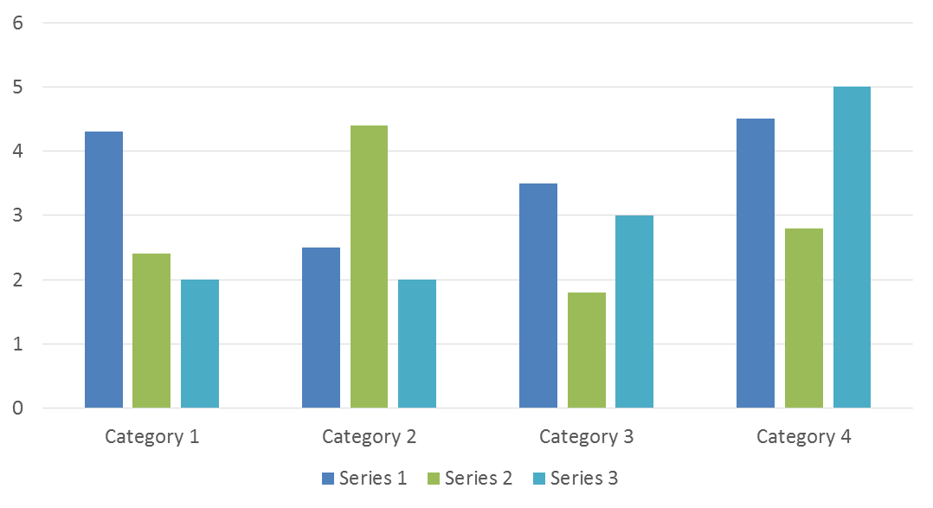
Slide heading [slide with graph]
Notes:
Normal slide with title and a graph.
Ensure that axis titles and labels (numbers) are not too small.

Slide 5
Conclusions/Recommendations
Line 1
Line 2
Line 3
Line 4
Line 5
Line 6
Line 7
Line 8
Notes:
Slide with Conclusions/Recommendations.

Slide 6
Notes:
Closing slide showing Cape Town Waterfront.
There is also an alternative closing slide under “Layout” with a heavy haul train!

